Slide 1
Hand Your Activity Packet into Class Inbox
for Previous Chapter
Your test was the Resume and Coverletter

Slide 2
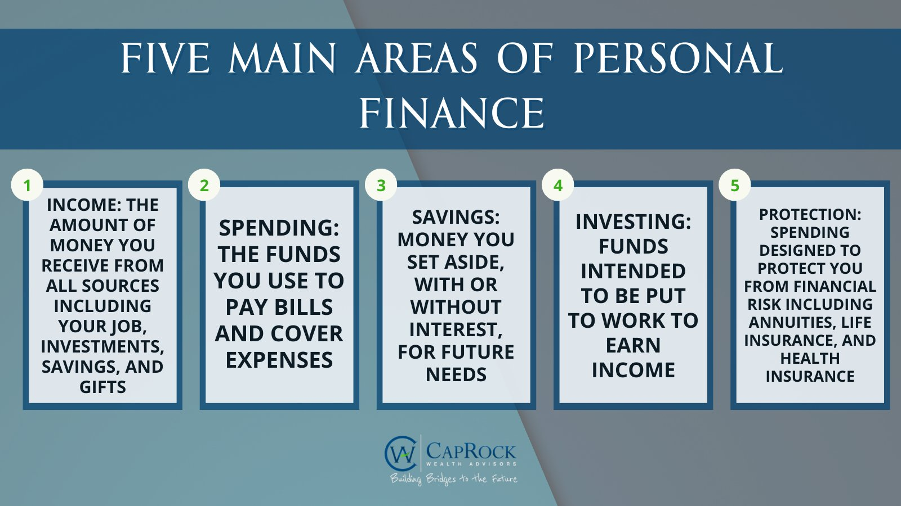
Spending

Slide 3

Withholding, Work Forms, and Work Laws
Work-Related Forms and Laws

Slide 4

Objectives:
What are withholdings
Who must pay taxes
How are my taxes paid
Required Work forms needed for employment

Slide 5
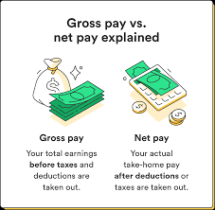
Two Types of Pay

Slide 6
Assignment
Complete the Google Classroom Assignment:
Edpuzzle – Where did my paycheck go.
Reminder each question is worth 2 points each.

Slide 7

Withholding Taxes
AKA DEDUCTIONS
Withholding : Money employers withhold from your paycheck and pay directly to the government
Pays for social security and Medicare taxes, income taxes, state and local taxes, 401 retirement plans
How are taxes paid?
  pay-as-you earn taxation

Slide 8
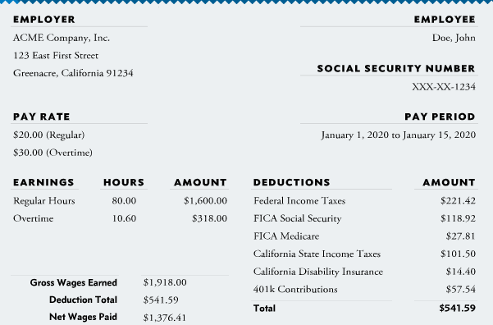

Slide 9
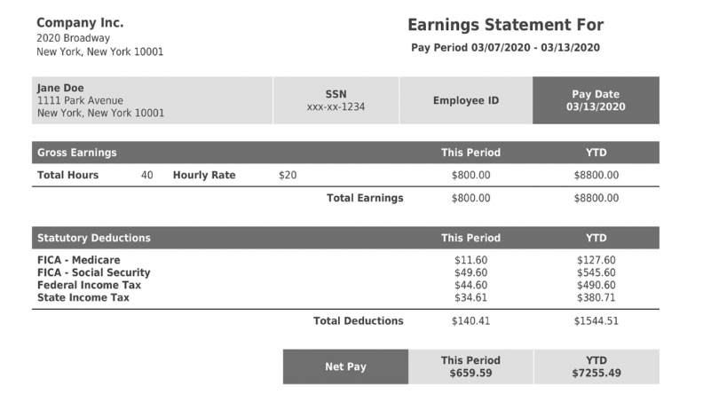

Slide 10
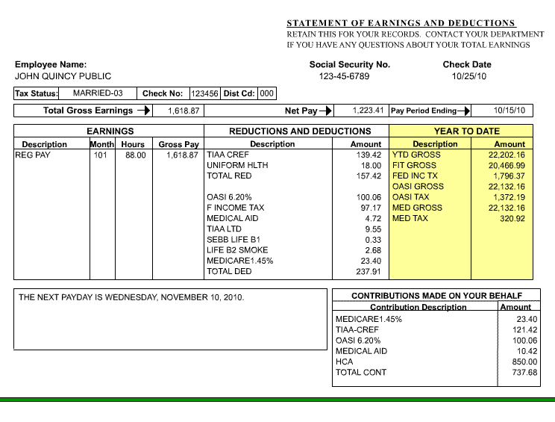


Slide 11
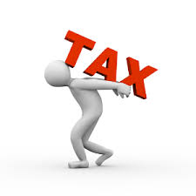

Who Must pay Taxes?
  Most people owe taxes on their income
  More you earn = more you owe
  Some are exempt from paying taxes
    Non-profit organizations
    US workers working Abroad
    Taxpayers with Many Deductions
    Taxpayers with Many Dependents
    Low-Income Taxpayers - If you earn an income that does not exceed the standard deduction

Slide 12
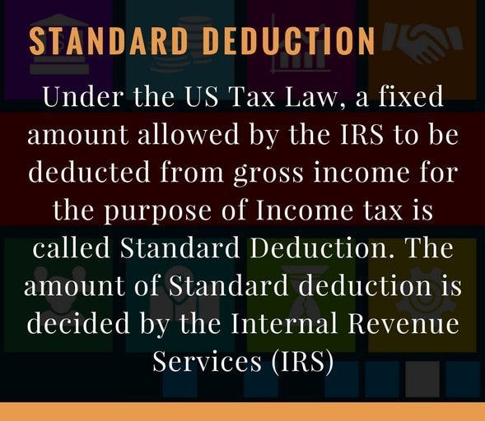
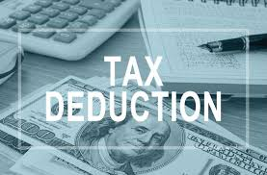
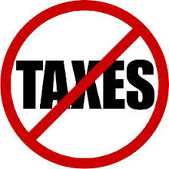
Did you Know?
Use you phone, chrome book, or a computer and answer the 2 questions in your activity packet on the bottom of page 1:
What is a Standard Deduction
How much is the 2024 Standard Deduction

Slide 13

Who Must pay Taxes?
  Standard deduction = The first $14,600 you earn is not taxed
  Employees don’t pay taxes directly to
  the government unless self employed
  Employers withhold this from your wages/salaries before you get your check
    Hence PAY as YOU EARN
  Most likely in high school you will
  not owe taxes as you will earn under the standard deduction.
  So Why are they withheld?

Slide 14
Who Must pay Taxes?
Tax rate | Single | Married filing jointly | Head of household | Married filing separately
10% | $0 to $11,600 | $0 to $23,200 | $0 to $16,550 | $0 to $11,600
12% | $11,601 to $47,150 | $23,201 to $94,300 | $16,551 to $63,100 | $11,601 to $47,150
22% | $47,151 to $100,525 | $94,301 to $201,050 | $63,101 to $100,500 | $47,151 to $100,525
24% | $100,526 to $191,950 | $201,051 to $383,900 | $100,501 to $191,950 | $100,526 to $191,950
32% | $191,951 to $243,725 | $383,901 to $487,450 | $191,951 to $243,700 | $191,951 to $243,725
35% | $243,726 to $609,350 | $487,451 to $731,200 | $243,701 to $609,350 | $243,726 to $365,600
37% | $609,351 or more | $731,201 or more | $609,351 or more | $365,601 or more
  US has a progressive tax system
  and is based on your filing status:
  The first $9,875 is at 10%
  12% from $9,876 - $40,124
  Some support for a Flat Tax Rate
Click to view more tax tables
https://www.nerdwallet.com/article/taxes/federal-income-tax-brackets

Slide 15
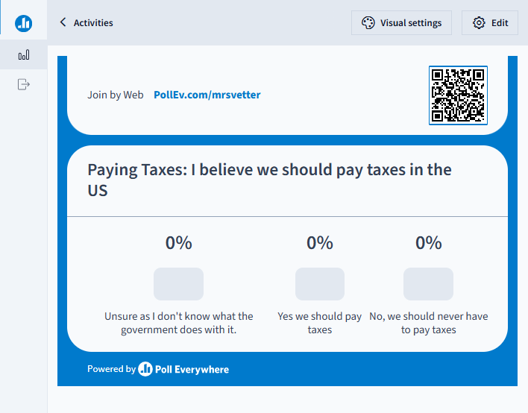

Slide 16
Why do We pay Taxes?
Go to Google Classroom and complete the Why we pay Taxes Assignment

